Slide 1


Curriculum Change & Approval Process
Curriculum Inventory Management (CIM) – CourseLeaf
Notes:
This is an introduction to the new curriculum approval software from CourseLeaf called Curriculum Inventory Management or CIM.

Slide 2
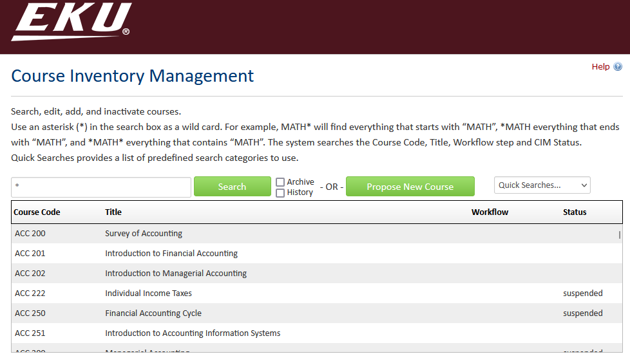

overview
CIM replaces PDF CAA forms
Course Form, Program Form, Miscellaneous Form
Integration with Catalog and Banner
Notes:
The goal of implementing CIM is to replace the current PDF forms currently in use to submit course and program change proposals. Where those forms are divided based on the type of change (editorial, routine, substantial, etc.) CIM forms are divided based on what is being changed, whether a course, program, or something like a prefix. CIM also integrates directly with Banner and the catalog. It will improve efficiency, reduce processing time, and enhance record keeping.

Slide 3
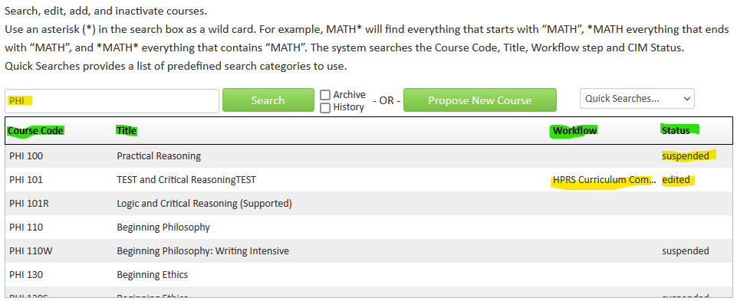

Course form
Search: Asterisk for All, Subject Code
Headers: Click Headers to sort
Workflow: Will have information after submission
Status: Suspended, Edited, or blank
Notes:
The top of the course form includes a search function and a database of all EKU courses. To see all available courses, put only an asterisk in the search bar. A subject code can be a good way to narrow down search results, but a specific course can also be searched. To sort the list, you can click on the headers like “Title” or “Status.” The workflow column will display the step of workflow a proposal is currently at, once it’s been submitted. The Status column will show suspended, editing, added, or be blank, depending on the status of the course/proposal.

Slide 4
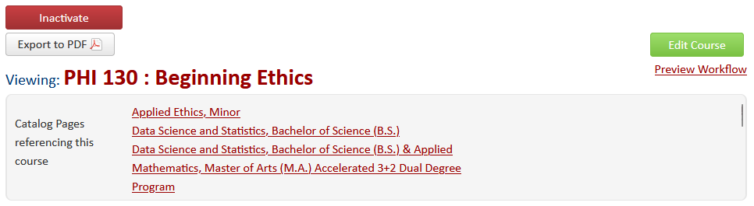
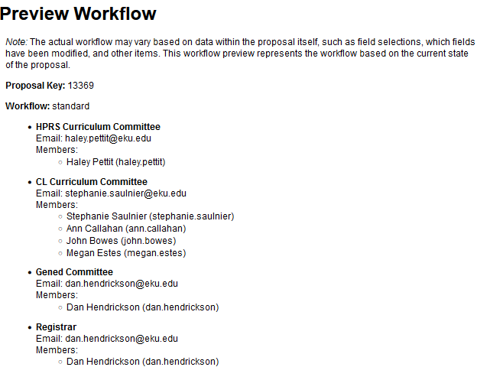
Course form
Display Course: Title, Ecosystem
Preview Workflow
Inactivate Button: Suspend Course
Start Workflow: button turns in any proposal, edit button gone
Notes:
The top of a course’s information contains information like the course code and title. Directly underneath is a list of catalog pages that reference the selected course. The Preview Workflow button shows where a submitted proposal would be sent based on how the fields are filled out. Some steps only appear if certain conditions are met, like Gen ed attributes. The Inactivate button pulls up a short form that replaces the request to suspend a course. The green Start Workflow button turns in any proposal. After this point it cannot be edited except by approvers in the appropriate workflow step. The workflow is based on particular people assigned to roles. Members of roles can be changed by request.

Slide 5
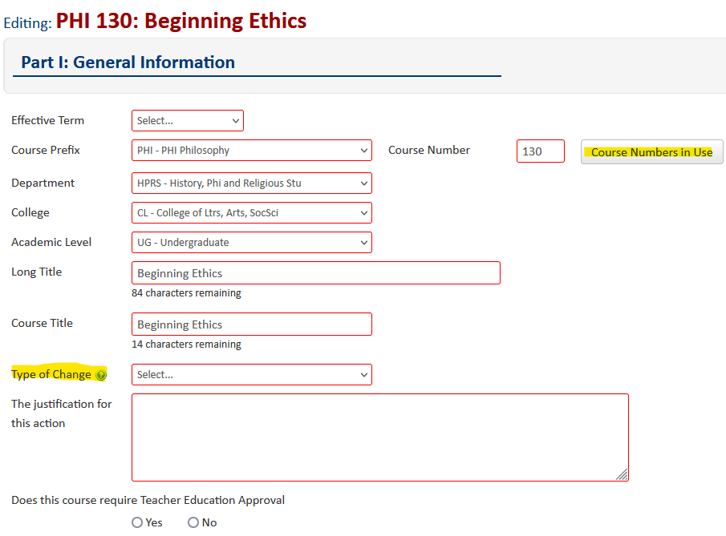
Course form
Edit Course
Red outline=Required field
Determines Workflow: Type of Change, Teacher Ed, Gen ed, GR Level, etc.
Save Changes
Course Numbers in Use
Notes:
Clicking “Edit Course” brings up the proposal form. Any fields that are outlined in red means that field must be filled in before the form can be submitted. Certain fields determine the workflow, such as “Type of Change,” Gen ed attributes, and GR level. Type of Change options include Editorial, Routine, and Substantial, mirroring the old PDF forms. The “Save Changes” button at the bottom of the page allows the proposal edits to remain without moving it forward to Workflow. The Course Numbers in Use button gives a list of course numbers currently in use with the selected subject code. This is to make it easier to find a unique number when creating a new course.

Slide 6
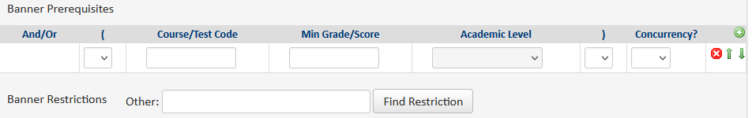
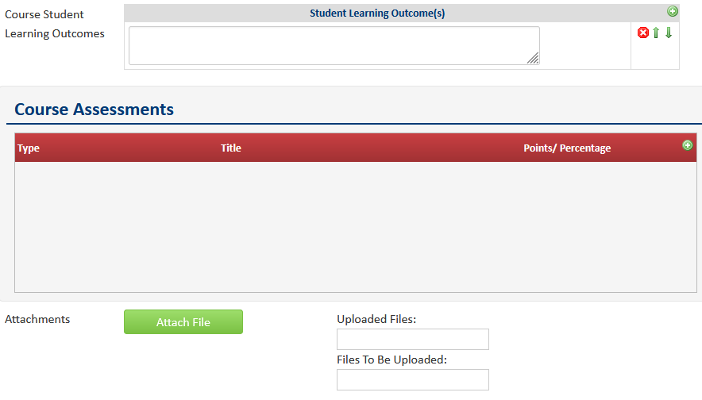
Course form
Banner Prerequisites – Do not Edit. List in Description
Find Restriction - Search
Student Learning Outcomes
Course Assessments – Replaces Test Scores
Attach File
Notes:
The Banner prerequisites field should not be edited. Any updates to prerequisites and corequisites should be listed in the course description. The find restriction search box can be used to assign registration restrictions to a course. It works the same way as the search bar at the top of the form. Course Assessments replaces test scores from the PDF forms. The Attach File button allows you to attach any relevant documents or other files to a course revision proposal.

Slide 7
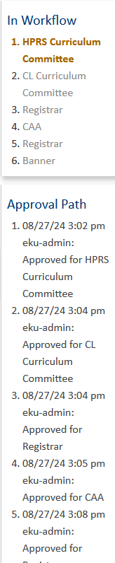

Course form
Workflow Window
Reviewer Comments
Notes:
Once a proposal is submitted, the edit button will be replaced with a workflow window showing where the proposal currently is in the approval path. Reviewer comments at the bottom of the page will display noted changes throughout the approval process.

Slide 8
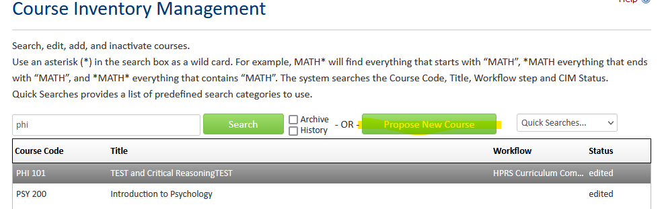
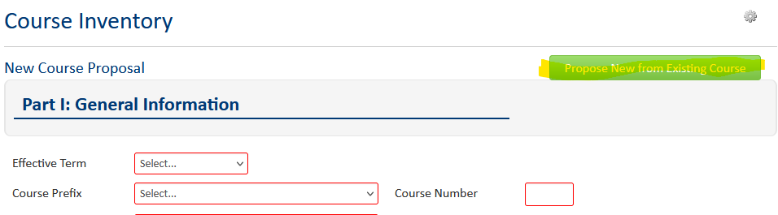
Course form
Propose New Course
Propose New from Existing Course
Notes:
Use the Propose New Course button to bring up a blank course proposal form. It has the same fields as the edit course form. The Propose New from Existing Course button allows you to select a course as a “starting point” and edit any differing fields.

Slide 9
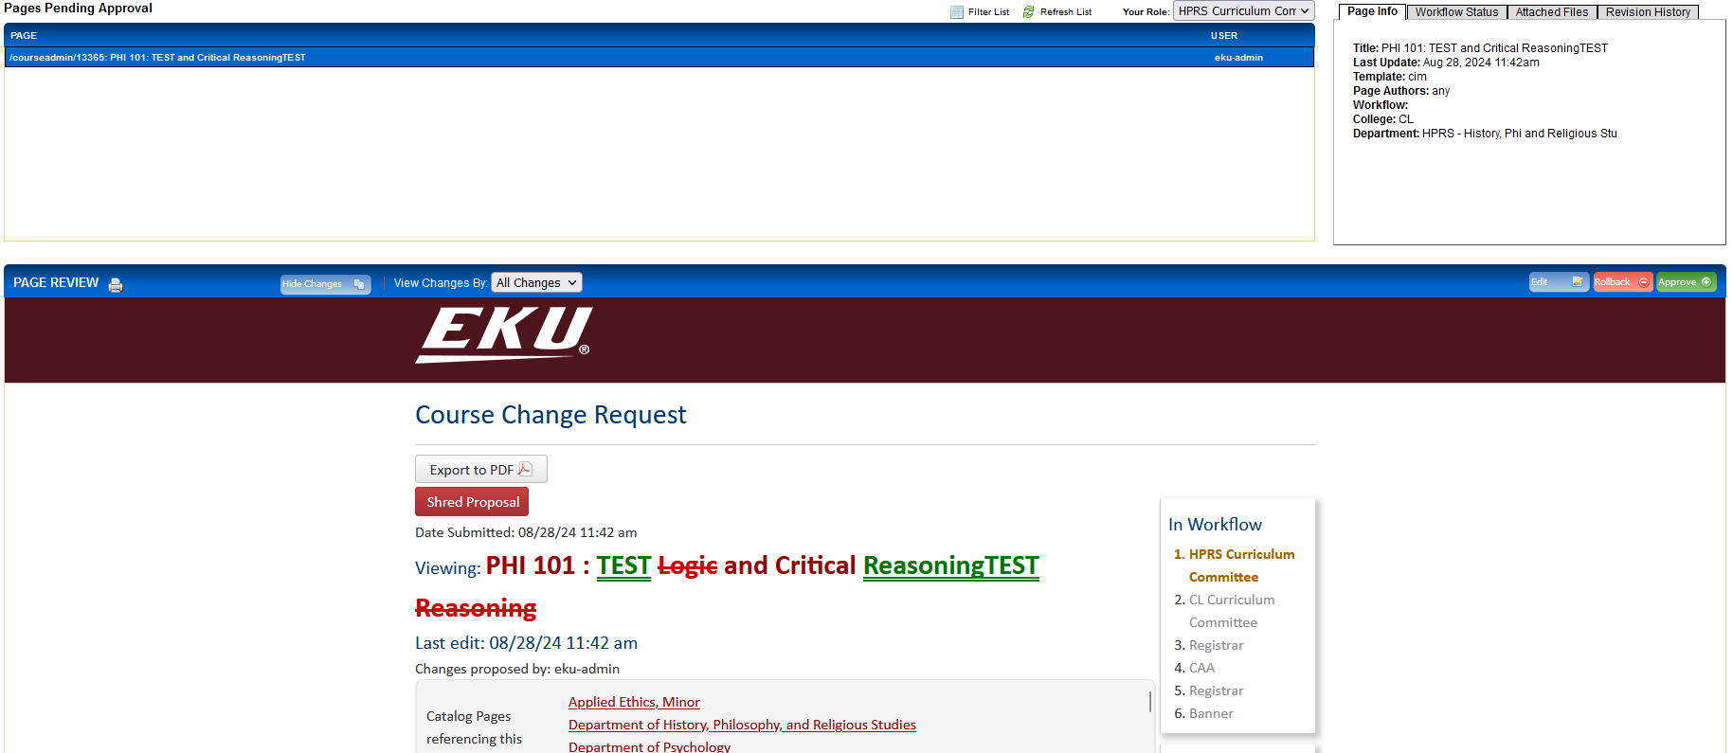
Course form
Approval Screen - Rollback
Red/Green Markup
Notes:
Approvers will visit the Pages Pending Approval page to review submissions. Approvers can make further edits to proposals, approve the page to move it forward in the workflow, or rollback the proposal with a comment, to an earlier approver or the original submitter. Any changes made by previous approvers will be marked up with green underlined text for additions and red crossed out text for deletions.

Slide 10
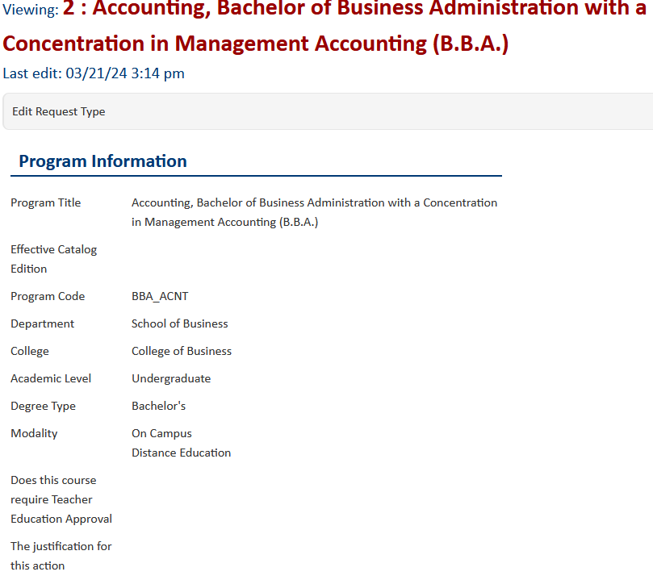
Program form
Similar interface to course form
Programs correspond with catalog pages
Program Key not relevant
New Program – DO NOT USE
Notes:
The program form has a similar interface to the course form with fields meant to mirror those on the program sections of the PDF form. Programs correspond with their catalog pages and integrate directly with the catalog itself. The program key is just meant to be a unique marker and is not relevant for submission purposes. Do NOT use the Propose New Program button. New programs must be proposed through the Miscellaneous form initially and then those are routed through the provost’s office.

Slide 11
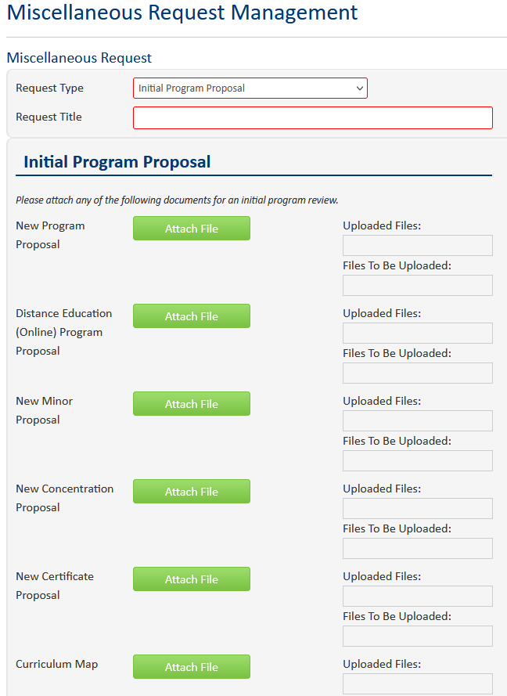
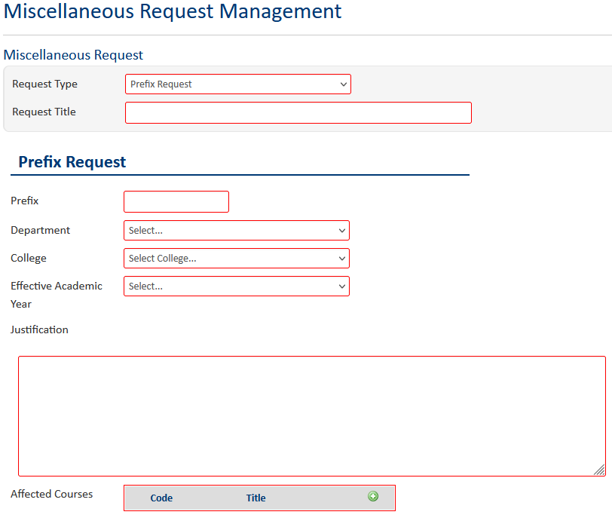
Miscellaneous form
Propose New Miscellaneous
New Program – Add Documents, moves to Provost’s office
Prefix – Add or remove course prefix
Clarify request in justification
List ALL affected courses
Notes:
This is the form you’ll use to propose a new program. Click New Miscellaneous Request then select Initial Program Proposal. Add all appropriate documents and start workflow to send them to the provost’s office for review. This form is also used to add or remove course prefixes. Be sure to make the end goal of the request in the justification section and list all affected courses using the picklist.

Slide 12
Questions? Contact Aaron reeder at aaron.reeder@eku.edu
Notes:
If you have any questions, feel free to reach out to me at aaron.reeder@eku.edu.

