Slide 1
CEAHS & CIM
Workflow for Curriculum Proposals
FIRST: Consult your Department Chair
SECOND: Email Associate Dean
See Checklists for requirements
THIRD: Department User enters proposal in CIM
and clicks “Start Workflow”
Department Designee receives an email with a link to the proposal

Slide 2
FOURTH: Department designee may:
Edit the proposal
Rollback to the User for edits
Download a PDF to share with others who do not have CIM access
Approve
Approve means “clicking the Approve button” after the department has voted to approve the proposal.
Clicking “Approve” records the approval date and moves the proposal to the next step in workflow (CCC). The Associate Dean’s office receives an email with a link to the proposal.
Proposals must be approved in CIM by the CCC materials due date.
Department Designees
AHS Dana & Teresa
ASLIE Danny
CTP Kellie & Stephanie
TLEL Nicola, Sonja & Kyrsten

Slide 3
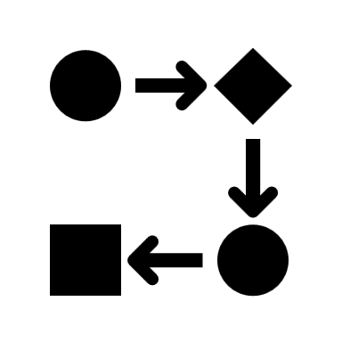
FIFTH: Associate Dean’s Office may:
Edit
AD’s office will make minor edits only with dept. approval.
Rollback
AD’s office standard practice will be to rollback proposals to the dept. for most edits.
Download a PDF
AD’s office will download proposals for the CCC agenda. Do not edit proposals after the materials due date.
Approve
AD’s office will “click the button” to record CCC approval date and move the proposal to the next step in workflow.
College Designees
CCC Michele & Dana
TEC Michele & Emily

Slide 4
NEXT STEPS:
Workflow to subsequent curriculum committees (Gen Ed, TEC, GOC, CAA) will continue as applicable.
A designee at each level will have the option to Edit, Rollback, Download to PDF, or Approve each proposal.

